Slide 1
Multi-Agent System for Smart Traffic Management
Seattle Data AI & Security Hackathon
Faiza Nuzhat
April 2025

Slide 2
A Next-Generation Approach to Urban Mobility
The Urban Traffic Challenge
Significant time loss for commuters and businesses
Increased pollution and fuel consumption
Static traffic signals fail to adapt to changing conditions
Poor emergency vehicle response times in congested areas
Inequitable distribution of traffic burden across neighborhoods

Slide 3
Our Solution: Collaborative AI Agents
An intelligent traffic management ecosystem where multiple AI agents work together to:
Dynamically adjust traffic signals based on real-time conditions
Create optimal routing recommendations for connected vehicles
Prioritize emergency vehicles while minimizing disruption
Ensure fairness in traffic distribution across the city
Provide human operators with oversight and control capabilities

Slide 4
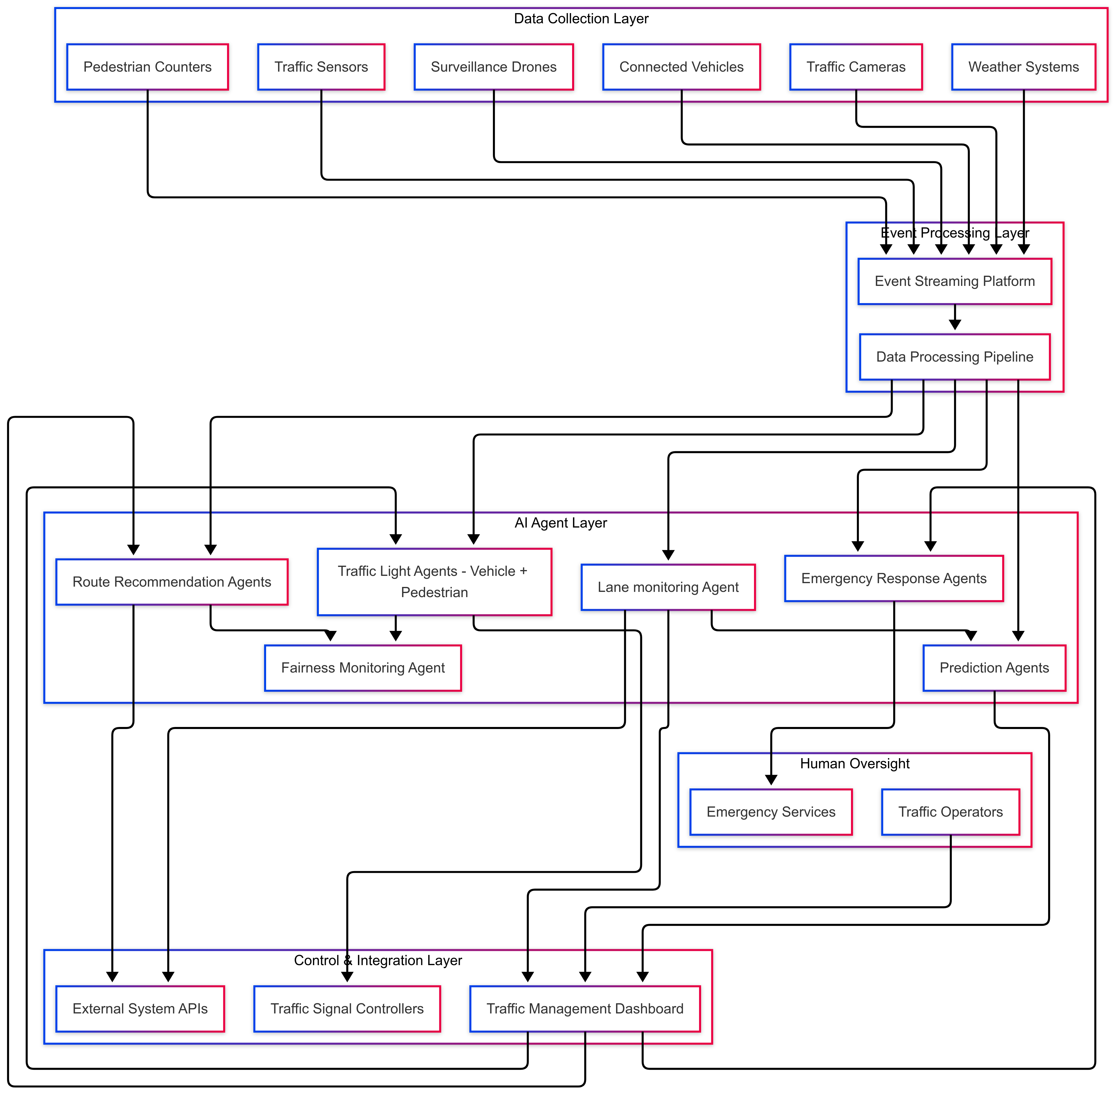
System Architecture
Data Collection Layer: Sensors, cameras, drones, connected vehicles
Event Processing Layer: Real-time event streaming and processing
AI Agent Layer: Specialized agents for different traffic management aspects
Control & Integration Layer: Human interfaces and infrastructure connections
Human Oversight: Traffic operators and emergency services

Slide 5
Agent Types and Responsibilities
Traffic Light Agents (TLA)
Adjust signal timing based on real-time conditions
Coordinate with neighboring intersections for "green waves"
Adaptively prioritize directions with higher congestion
Route Recommendation Agents (RRA)
Analyze citywide patterns to suggest optimal routes
Communicate with vehicles through V2I protocols
Balance route distribution to prevent new congestion points
Emergency Response Agents (EMA)
Create dynamic emergency corridors for first responders
Coordinate with TLAs to adjust signals along emergency routes
Track emergency vehicle progress and restore normal operations
Prediction Agents (PA)
Forecast traffic patterns based on historical data and conditions
Identify potential congestion hotspots before they form
Provide decision support with forward-looking insights
Fairness Monitoring Agent
Ensure equitable distribution of wait times across neighborhoods
Monitor for and correct bias in routing recommendations
Track accessibility metrics for all road users

Slide 6
Event-Driven Communication
Decoupled agent interactions through standardized events
Rich contextual information for intelligent decision-making
Asynchronous processing for scalability and resilience
State Preservation Mechanism
Persistent Event Store: Complete record of all events and decisions
State Snapshots: Periodic checkpoints of agent internal state
Real-time State Synchronization: Consistent state across distributed agents
Recovery Capability: Quickly resume from failures without data loss
Human-in-the-Loop Integration
Human validation for critical decision
Manual Override
Monitoring Dashboards
Feedback Loop: Operator input improves agent decisions over time

Slide 7
Ethical Framework
Fairness and Equity: Equal treatment across neighborhoods and times
Transparency: Explainable decisions and public performance metrics
Privacy Protection: Anonymization and data minimization
Human Oversight: Clear control mechanisms and review processes
Failure Safety: Graceful degradation and safe defaults
Key Simulation Scenarios
Rush Hour Management: Optimizing flow during peak congestion
Emergency Response: Creating dynamic corridors for first responders
Weather Events: Adapting to rain, snow, or other conditions
Special Events: Managing traffic for concerts, sports, or festivals
Infrastructure Failures: Resilience when signals or sensors malfunction

